Slide 1
5G ACADEMY 2026 · FASTWEB + VODAFONE · TOPIC 2 - SECURITY
AEGIS
Zero-Trust Identity for AI Agents on the Network
Credentials prove what you have - AEGIS verifies how you behave.
Gate 1 - Project Proposal · prepared for the 2 September dev meeting
Team 4 - Fauzan Ejaz (Captain) · Adithya Zacharia Valavi · Ghazanfar Anees Siddiqui · Llagami Tedi
Notes:
FAUZAN · 0:00-1:00 · Intro
Good morning. We're Team 4 and we're presenting AEGIS, a zero-trust identity check for the AI agents and automations that now operate the 5G network. One line to remember us by: credentials prove what you have, AEGIS verifies how you behave. I'm Fauzan, team captain, and with me are Adithya, Ghazanfar and Llagami, we'll each walk through a part of this.

Slide 2
BEFORE WE START
Five terms you'll hear today, in plain English
No prior 5G or AI knowledge assumed. Everything below is all you need to follow the rest of this talk.
Network Function
One specialised system inside the 5G network, like one department in a company (example: the system that tracks device sessions).
Agent
An automated piece of software, a bot or script, that logs in and calls the network on its own, with no human clicking anything, the way an employee would use an internal tool.
Behavioural fingerprint
The normal working pattern we learn for each agent, what it usually does, when, and how often, so we can tell if it starts acting differently.
Risk score
A single number from 0 to 1 that says how unusual an agent's recent activity looks compared to its own normal pattern.
PASS / STEP-UP / BLOCK
The three outcomes: let it through, challenge it for extra verification, or stop it and alert a human.
AEGIS · Zero-Trust Identity for AI Agents · Team 4
2
Notes:
FAUZAN · 1:00-2:00 · Plain-English primer
Before we go further, five quick terms so nothing after this sounds like jargon. A Network Function is one specialised system inside the 5G network, think of it like one department in a company. An agent is a piece of automated software that logs in and acts on its own, no human clicking anything. A behavioural fingerprint is the normal working pattern we learn for each agent. A risk score is one number from 0 to 1 saying how unusual an agent's recent activity looks. And PASS, STEP-UP, BLOCK are the three outcomes: let it through, challenge it, or stop it and alert a human. Keep these five in your head and the rest of this talk will make full sense.

Slide 3
THE PROBLEM · WHY NOW
Machine agents now command the network
As networks become AI-native, automations - not humans - call the control plane.
The shift
The gap
The answer
Orchestration, closed-loop automation, OSS jobs and LLM copilots call 5G Network Functions over the Service-Based Interface (SBI) - the same control APIs a human operator's tooling uses.
A stolen token or a compromised automation account passes AAA - the credential is valid, but the actor behind it is not. Authentication asks “is the credential valid?”, never “is this really our agent, behaving as it always does?”
Zero-trust for machine identities (NIST SP 800-207): learn each agent's behavioural fingerprint and verify every request against it - continuously. Never trust, always verify.
In scope: orchestration / API agents on network control services - a control-plane security problem that exists today, not a general “AI safety” concept.
AEGIS · Zero-Trust Identity for AI Agents · Team 4
3
Notes:
ADITHYA · 2:00-5:00 · The problem
As networks become AI-native, it's increasingly automations, not humans, calling the network's control systems directly, orchestration tools, closed-loop automation, AI copilots. Here's the gap: today, the only check on these agents is a login check, does the credential work. But a stolen or misused credential still passes that check every time, the password is valid, but the actor behind it isn't who it should be. Authentication can only ever answer 'is this credential valid', never 'is this really our agent, behaving the way it always does'. That second question is what AEGIS answers, continuously, in line with the zero-trust principle of never trust, always verify. And to be clear on scope: this is about machine agents on the network's control systems, not end users, and not general AI safety, a concrete security gap that exists today.

Slide 4
THREAT MODEL
Seven threats - all built and detected
We assume the attacker already holds a valid credential. AEGIS catches them by behaviour.
T1
Impersonation
T2
Compromised agent
T3
Recon / enumeration
valid token, wrong role
legit agent starts new actions
scanning endpoints & IDs
↳ endpoint mix / timing mismatch
↳ drift from its own baseline
↳ high error rate, broad surface
T4
Volumetric abuse
T5
Exfiltration
T6
Bad call sequence
flooding a Network Function
quiet, large data pulls
release before create
↳ request-rate spike vs envelope
↳ payload size + off-hours
↳ orphan session state machine
T7
Scope creep
All 7 detected
in the working baseline - see results.
touching NFs outside role
↳ out-of-scope access
AEGIS · Zero-Trust Identity for AI Agents · Team 4
4
Notes:
ADITHYA · 5:00-8:00 · Threat model
We assume the attacker already has a valid credential, the realistic, hard case. We modelled seven ways that credential could be misused: impersonation, where an identity suddenly behaves like a completely different one; a compromised agent drifting into new behaviour; reconnaissance, broad scanning across systems it wouldn't normally touch; a volumetric flood; slow, quiet data exfiltration; a broken call sequence, like closing something that was never opened; and scope creep, touching a system outside its role entirely. All seven are built into our working prototype and, as we'll show, all seven are currently detected.

Slide 5
ARCHITECTURE
OBSERVE → FINGERPRINT → SCORE → DECIDE
A zero-trust gate on every agent→NF request. Production: an inline policy check at the edge (FASTedge).
01
OBSERVE
02
FINGERPRINT
03
SCORE
04
DECIDE
Parse each request: agent id, method, NF, endpoint, timing, payload, status.
→
Windowed behavioural vector vs the agent's known-good baseline (scope, rate, sequence, errors).
→
Rules (hard limits) + ML anomaly (Isolation Forest, trained on legit only) → risk 0–1.
→
Thresholds → PASS / STEP-UP / BLOCK, with a plain-language reason.
PASS
STEP-UP
BLOCK
behaves like its known-good self
challenge - re-auth / approval / throttle
quarantine the identity, alert the SOC
Fingerprint features: request rate & inter-arrival · distinct NFs/endpoints · method mix · call-sequence (session state machine) · error rate · payload size · time-of-day.
AEGIS · Zero-Trust Identity for AI Agents · Team 4
5
Notes:
GHAZANFAR · 8:00-11:00 · Architecture
Here's how the gate actually works, four steps. First, Observe: every request an agent makes gets logged, who, what, when, how big, what came back. Second, Fingerprint: we build a short-term behavioural profile for that agent and compare it against its own normal pattern. Third, Score: two independent checks run together, a set of hard, clear-cut rules, and a machine-learning model trained only on normal behaviour, that spots anything statistically unlike that agent's usual self. Those combine into one risk number. Fourth, Decide: fixed thresholds turn that number into pass, step-up, or block, always with a plain-language reason attached, never a black box. In production, this would run inline at the network edge; today it runs on replayed traffic.

Slide 6
TECHNOLOGY STACK
Open-source, reproducible, edge-deployable
Everything the PoC needs runs on open-source; internal platforms are an upgrade, not a dependency.
DATA
DETECTION
GATE & DEMO
- Synthetic 5G SBA traffic generator (5 agents, threats T1–T7)
- 208k labelled requests over the Service-Based Interface
- Real M2M / API-gateway logs pluggable if offered
- Isolation Forest (scikit-learn), trained on legit only
- Deterministic rules + session state machine
- Held-out calibration → honest operating point
- Streamlit zero-trust gate dashboard (PASS/STEP-UP/BLOCK)
- Per-agent risk, incident inspector, plain-language ‘why’
- Production vision: inline policy check at FASTedge
STANDARDS & FRAMEWORKS
NIST SP 800-207 Zero-Trust · 3GPP Service-Based Architecture (SBI) · TM Forum closed-loop / OODA · aligns to NIS2 · GDPR · EU AI Act auditability
AEGIS · Zero-Trust Identity for AI Agents · Team 4
6
Notes:
GHAZANFAR · 11:00-13:30 · Technology
Everything here is open-source and runs on an ordinary laptop, no special hardware or licensing. On the data side, we built our own synthetic traffic generator producing labelled 5G-style requests, real logs are pluggable later if offered. On detection, it's a standard machine-learning library, plus deterministic rules and a session state machine, calibrated honestly on data the model never trained on. And for the gate itself, we built a live interactive dashboard showing every decision with its reasoning, which we'll show you running in a moment. This all lines up with recognised standards, zero-trust guidance, the 5G architecture standard, and supports compliance frameworks like GDPR and the EU AI Act.

Slide 7
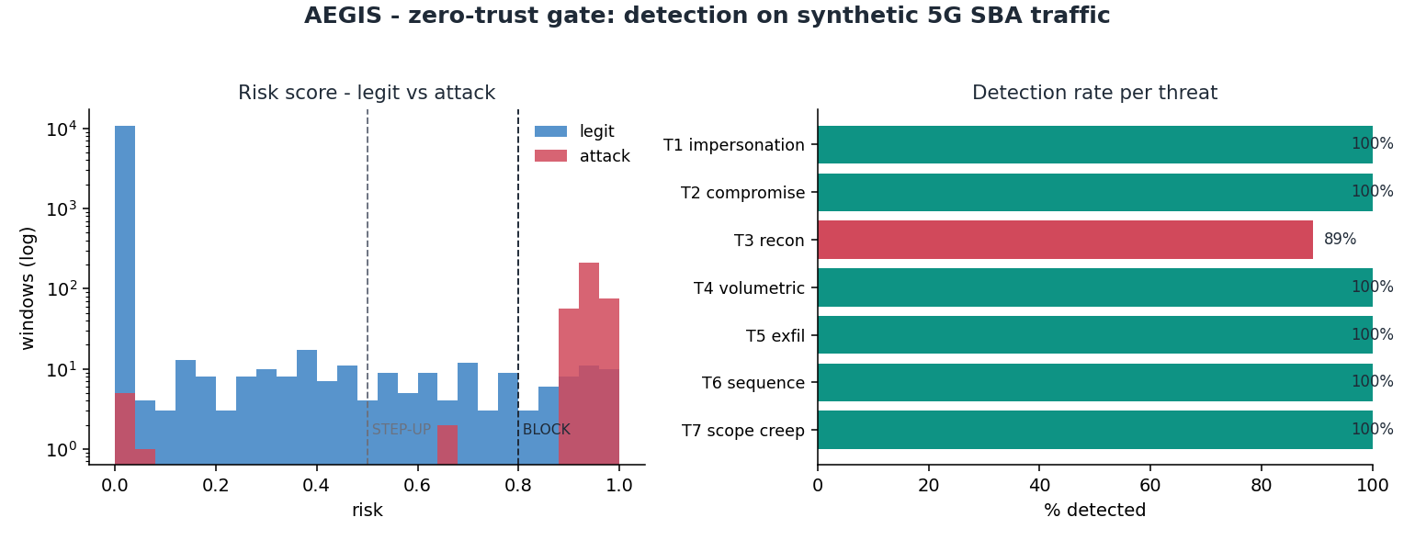
PROOF IT WORKS · WORKING PoC
Results on synthetic 5G SBA traffic
A working prototype already at proposal stage - validated on 11,343 held-out request windows.
0.99
98%
0.8%
7 / 7
ROC-AUC
RECALL
FALSE POSITIVES
THREATS COVERED
Reading it
Left: legit traffic sits near risk 0; attacks separate cleanly above the STEP-UP/BLOCK lines.
Right: every threat T1–T7 detected (recon 89%, the rest ~100%).
STEP-UP is a soft challenge; only ~0.8% of legit traffic is ever flagged.
AEGIS · Zero-Trust Identity for AI Agents · Team 4
7
Notes:
LLAGAMI · 13:30-17:00 · Proof it works
This isn't a design target, it's a working prototype, already producing real numbers. On our held-out test data, over eleven thousand time windows the model never saw during training, we correctly separated attacks from normal traffic 99% of the time, caught 98% of every attack we injected, and wrongly flagged fewer than 1% of legitimate traffic. All seven threat types are detected. On the left, you can see normal traffic sitting calmly near zero risk while attacks spike clearly above our decision lines, on the right, detection broken down by attack type. The one honest caveat: this proves the method works on data we built ourselves, real traffic is the next validation step, which is exactly what we're asking Fastweb and Vodafone for.

Slide 8
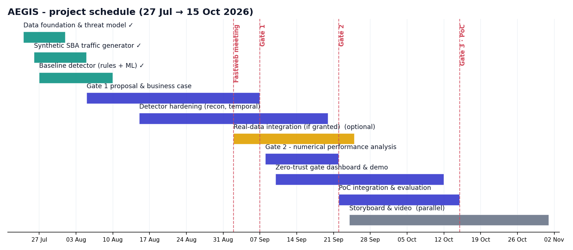
PROJECT SCHEDULE
From proposal to a working PoC by 15 October
Green = already done. Data foundation, synthetic generator and the baseline detector are complete; the path to Gate 2/3 is hardening, dashboard and evaluation.
AEGIS · Zero-Trust Identity for AI Agents · Team 4
8
Notes:
LLAGAMI · 17:00-19:30 · Schedule
Here's where we actually are. Everything in green is done already: the threat model, the synthetic data generator, and the baseline detector you just saw results from, that's not a plan, that's built and working. From here to Gate 2 on 22 September, we're hardening detection and building out the full numerical analysis. Real-data integration slots in if we're granted access. Gate 3 on 15 October is the live, end-to-end zero-trust gate demo, with the video shoot running in parallel after that.

Slide 9
BUSINESS CASE & FEASIBILITY
Why it matters - and why it’s deliverable
Illustrative value model, to be validated with Fastweb + Vodafone.
Risk avoided
Enables safe automation
Detects a compromised / spoofed automation before it acts on the control plane - cutting mean-time-to-detect from hours to seconds and containing blast-radius.
Zero-trust on machine identities is the guardrail that lets the network move up the autonomy curve (closed-loop / self-healing) without new risk.
Compliance & audit
Low OPEX
Supports a NIS2 zero-trust posture; every decision is logged and explainable - direct evidence for GDPR / EU AI Act accountability.
Automates machine-identity monitoring that no SOC can do by hand at API scale.
FEASIBILITY
Synthetic-first, so no data approvals block us - and the baseline already works (ROC-AUC 0.99). Real data upgrades it from credible to proven.
AEGIS · Zero-Trust Identity for AI Agents · Team 4
9
Notes:
LLAGAMI · 19:30-23:00 · Why it matters, why it's deliverable
Four reasons this has real value: it avoids risk, catching a compromised automation before it acts, cutting detection time from hours to seconds. It enables safer automation, giving operators the confidence to expand closed-loop, self-healing systems. It supports compliance, every decision is logged and explainable, which is exactly what regulations like GDPR and the EU AI Act ask for. And it's low-effort operationally, automating a kind of monitoring no security team could do by hand at this scale. On feasibility, because we're synthetic-first, no data approval process blocks us from having a working system today, and the baseline numbers already prove the method. Real data only makes it stronger, it isn't a dependency.

Slide 10
ASKS & NEXT STEPS
What we need - and where we go next
STILL OPEN, FOLLOWING UP AFTER 2 SEP
ROADMAP TO GATE 2 & 3
- Real (or anonymised) network traffic to validate against, even a small sample or field distributions.
- Whether FASTedge exposes a hook to run our check inline, so a BLOCK can actually stop a request, not just flag it.
- Which agent or automation types (orchestration, OSS jobs, closed-loop, external access) matter most to you, so we prioritise correctly for Gate 2.
- Gate 2 (22 Sep): full numerical performance analysis + hardened detector (recon, temporal, ROC operating points).
- Integrate real logs if granted; add more agent profiles & attack variants.
- Gate 3 (15 Oct): live zero-trust gate dashboard demoing PASS / STEP-UP / BLOCK end-to-end.
- Parallel: storyboard (24 Sep) → shooting (Oct) → final video (1 Nov).
Credentials prove what you have - AEGIS verifies how you behave.
AEGIS · Zero-Trust Identity for AI Agents · Team 4
10
Notes:
FAUZAN · 23:00-27:00 · Asks and close
To close, here's what's still open and where we're headed. We're still following up with Fastweb and Vodafone on three things: real or anonymised traffic to validate against, whether FASTedge can let our gate actually block a request inline rather than just flag it, and which agent types matter most to you so we prioritise correctly. Between now and Gate 3 on 15 October, we're hardening the detector, building the full live dashboard demo, and integrating real data if it's made available. We're confident in this direction because the hardest part, proving the detection method actually works, is already done, working, and in front of you today. Thank you, happy to take questions.

